Slide 1

COVID
MANAGEMENT
SANDEEP REDDY DODDA(20071A05A6)
SANKIRTH POLSANI(20071A05A7)
SILIVERU SURESH(20071A05A8)
SAI SAMANVITHA SIRIVOLU(20071A05A9)
SOLLU YASHWANTH SAI(20071A05B0)

Slide 2
ABSTRACT
This project is based on collecting the details of the patient, symptoms exhibited, displaying status of treatment and storing vaccination details. It includes collection of details of the patient, symptoms tracking, classification of the disease (light, moderate, severe), storing the details of the patient, collecting details regarding vaccination.
Features of the project.
Collection of patient details through SQL.
Symptom assessment
Maintaining record of the patient details in a Database
Storing the details of all vaccinated individuals
Storing vaccination centre details in a database.

Slide 3
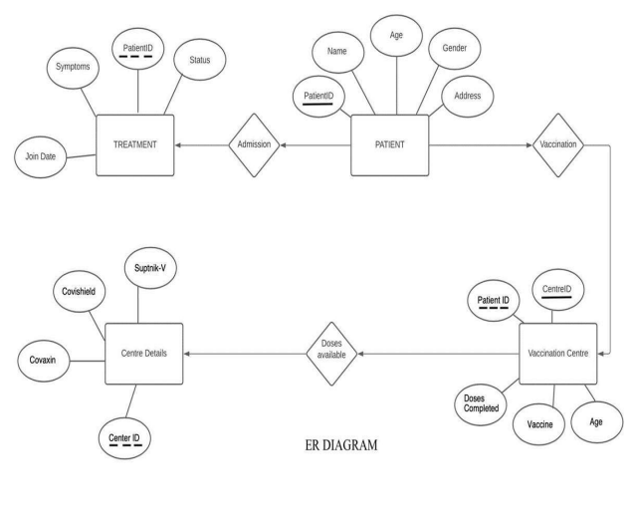
ER DIAGRAM

Slide 4
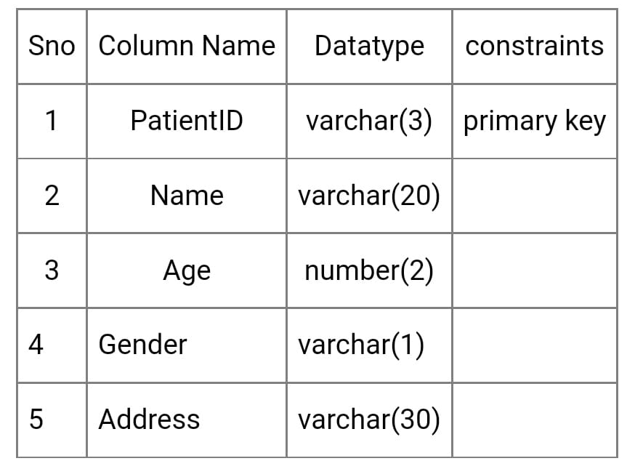
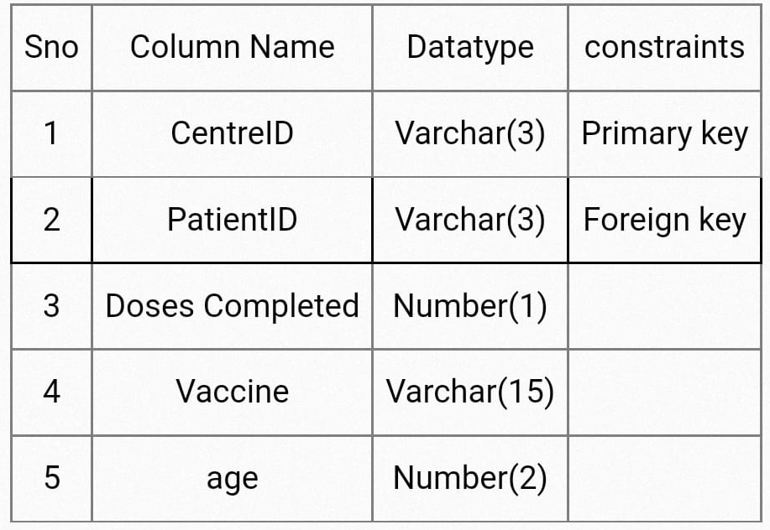
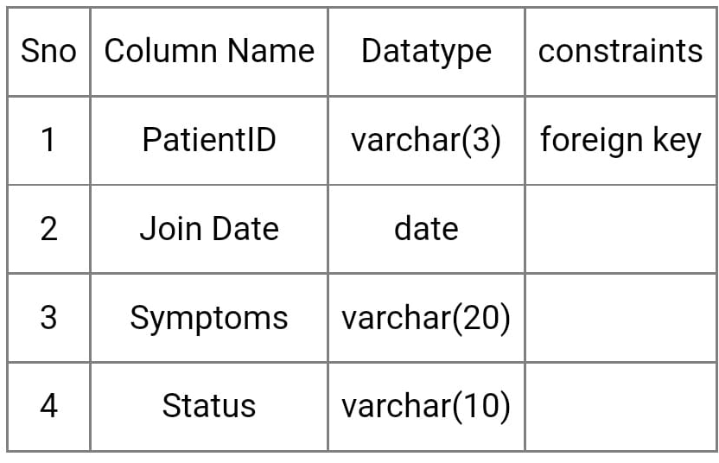
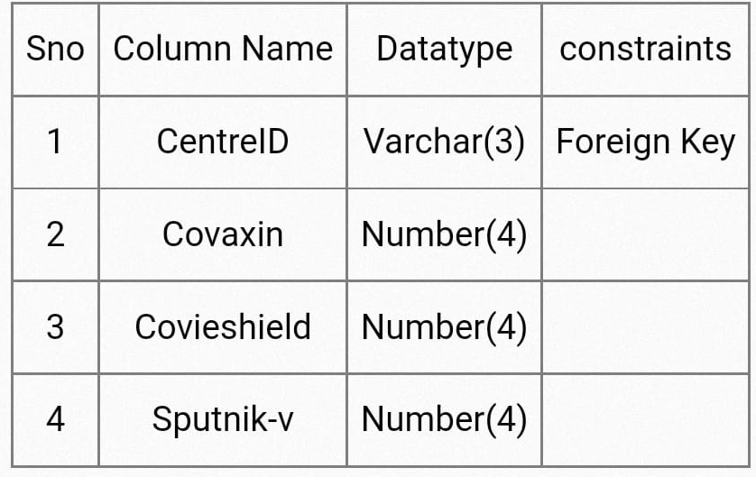
SCHEMA
PATIENT :
VACCINATIONCENTRE :
TREATMENT :
CENTREDETAILS:

Slide 5
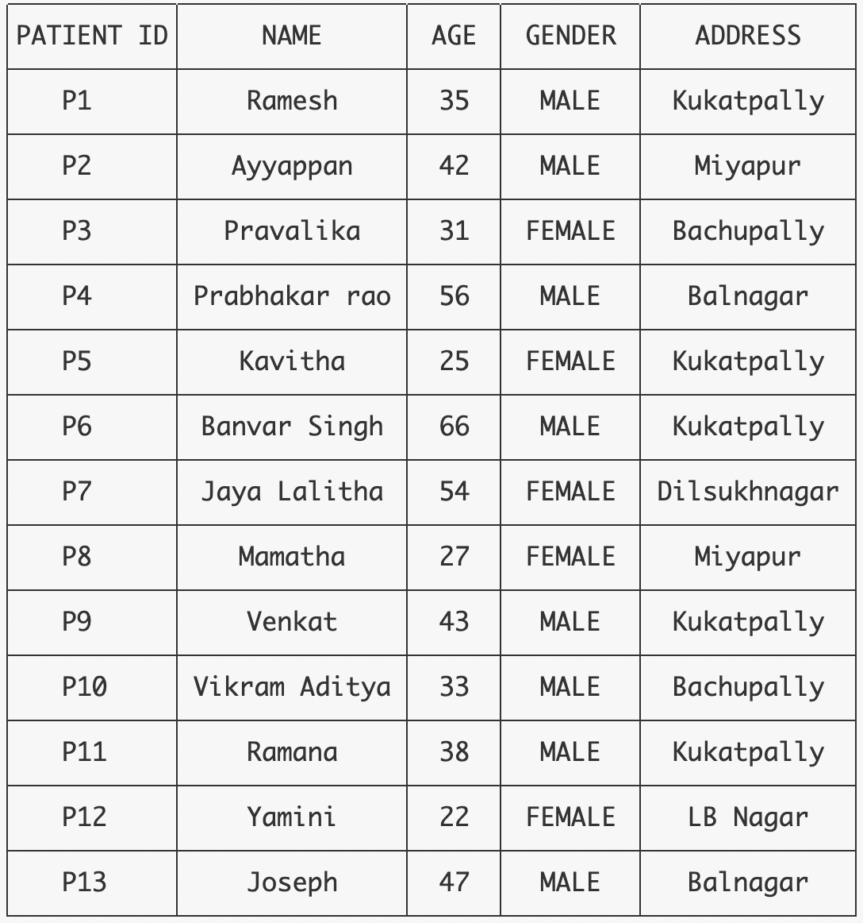
SAMPLE INSTANCE OF EACH TABLE
PATIENT :

Slide 6
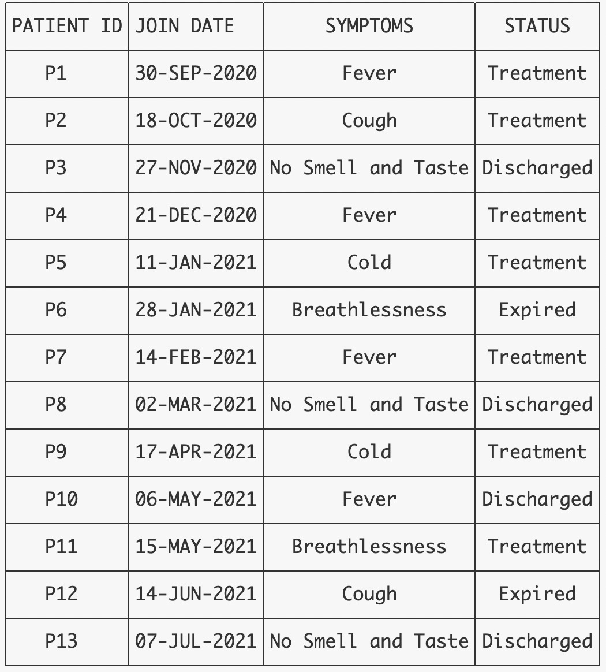
TREATMENT:

Slide 7
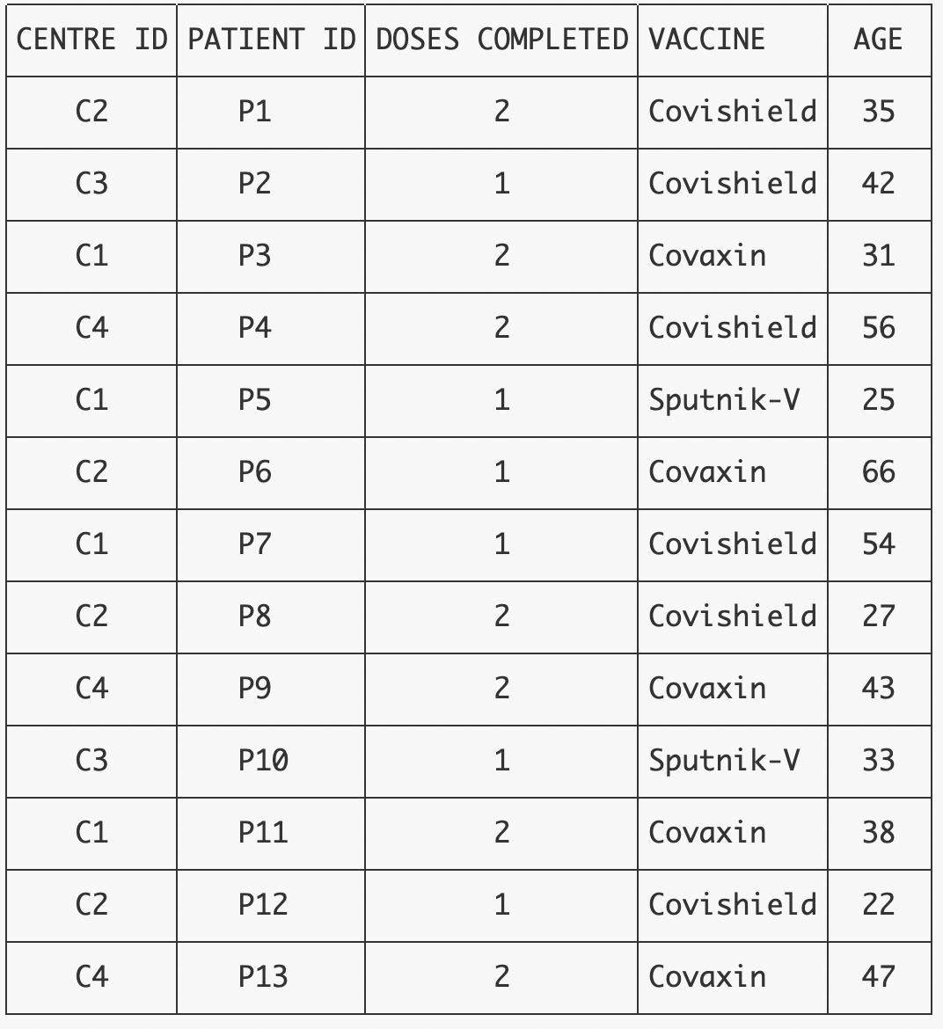
VACCINATIONCENTRE:

Slide 8
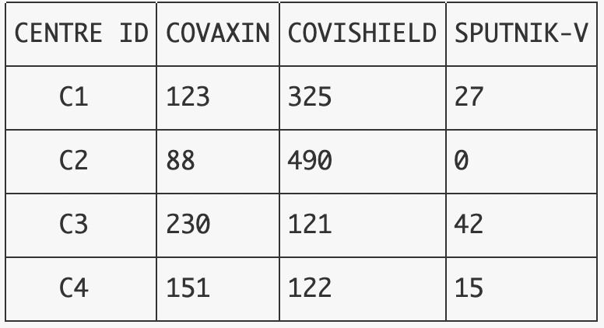
CENTREDETAILS:

Slide 9
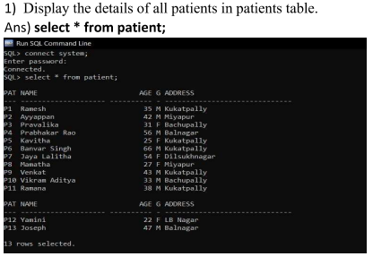
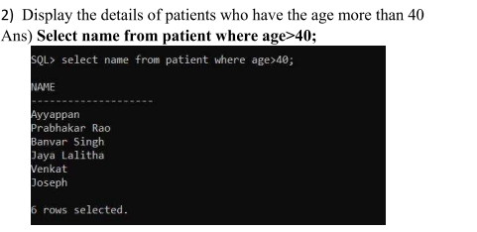
SAMPLE QUERIES

Slide 10
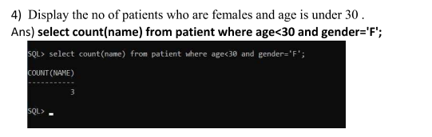
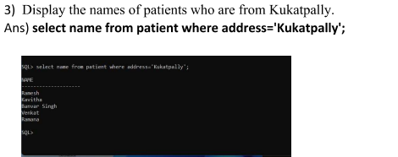

Slide 11
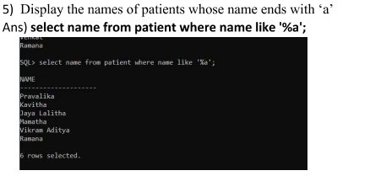
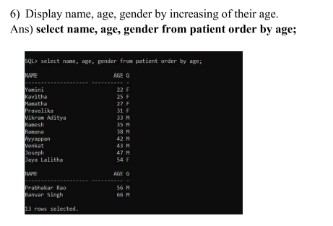

Slide 12
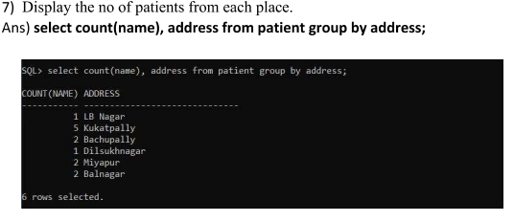
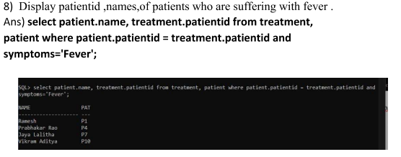

Slide 13
This project can be extended by including number of hospitals in the city or locality and form a Covid Patient Database and regularly monitor the symptoms and status of treatment of the patients in various hospitals located at various places.
This project can be useful to government nodal teams working on data analysis of vaccinated patients affected with covid.
FUTURE SCOPE

Slide 14
The project can store details of the patients who are vaccinated and, their treatment status along with their personal details.
Through this project, retrieval of patient's personal info and their vaccination history along with number of doses, becomes easy and time saving.
Also, This project can help us collect the data of the efficacy of vaccines as it contains the status of treatment which includes data of the patients expired.
Also, the symptoms data which is included in the treatment table, allows us to find out which vaccine is working efficiently and also the efficacy of one and two doses of each vaccine can be found out.
CONCLUSION

Slide 15


